Slide 1
The week 11 interim interview presentation on HECC-IT
Hypertext Editing and Creation Code Integrated Toolkit
A toolkit for making hypertext games
by Rachel Lowe

Slide 2
Why am I doing this project
It looked interesting
Making a thing that others can make things with
Might actually be of some use to someone!
Nice change of pace from everything else
Art reasons
You ever just make a game for the sole purpose of getting stuff off your chest
Logistics
Doesn’t require specialised hardware/software

Slide 3
The design goals
Make a tool for people who are indecisive.
Most existing tools are either 100% text-based (inform, squiffy, undum, etc) or 100% GUI-based (storyspace, twine, TADS, etc)
Some tools almost allow both, but awkwardly
Can convert twee code to twine, awkward to decompile (especially on Windows)
Inklewriter to/from .ink code: really longwinded
HECC-IT solves this problem
User can write .hecc code or use the OH-HECC GUI to help them write it
User can use HECC-UP to convert .hecc into a game
Make the games easy (technically) to play
Browser-based, 100% clientside, HTML/JavaScript
If people can’t use the outputs, what’s the point?
Follow the Treaty of Babel standard for Interactive Fiction Bibliography
So it’s more legit basically

Slide 4
The Objectives for the MVP
Create a system for playing hypertext games via a web browser
The HECCIN Game
Establish a language that can be used to define hypertext games
HECC
Create a utility that can parse that intermediate code into a playable hypertext game
HECC-UP
Create a GUI program that can be used to create that intermediate code
OH-HECC

Slide 5
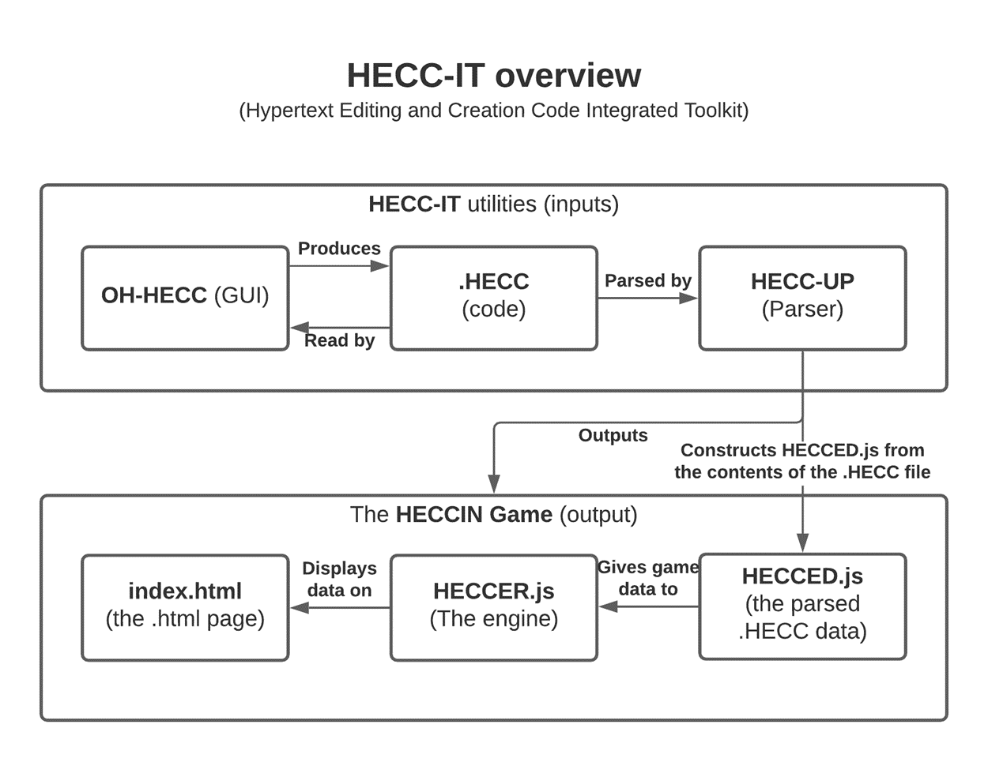

Slide 6
The .hecc language (Hypertext Editing and Creation Code)
Syntax is very similar to that of Twee and Squiffy
Familiarity for people who already use those
Defined in the HECC-SPECC
HECC Super Precise Explanation for Creating Code
Has metadata
Author, game title, comments, start passage, IFID
Can define passages
Passage names, position in OH-HECC, tags, comments, and content
Passages also hold links to other passages

Slide 7

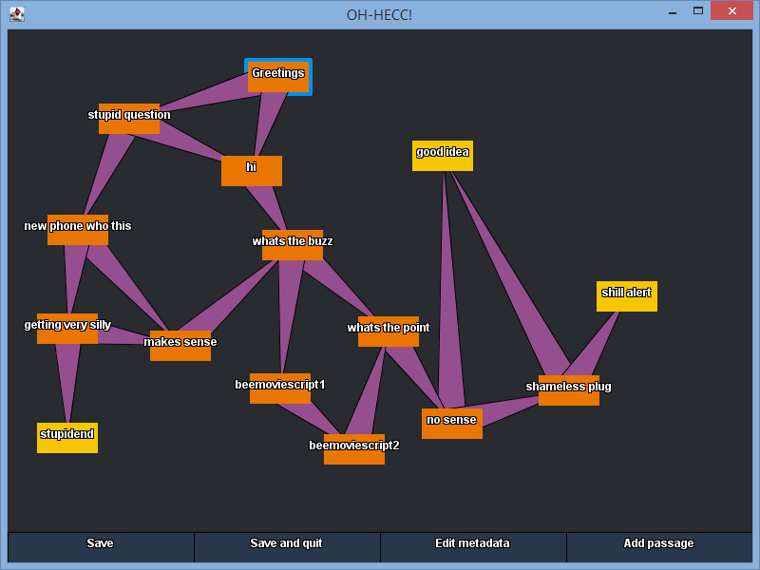
OH-HECC (Optional Help for HECC)
GUI for editing HECC
Can open existing .hecc files or make and edit a new .hecc file
Similar in functionality to Twine
Network of connected passages
Easy to add/edit/remove passages
Can edit metadata
Namesake was said several times whilst developing it.
But users hopefully won’t find themselves having to say it.

Slide 8
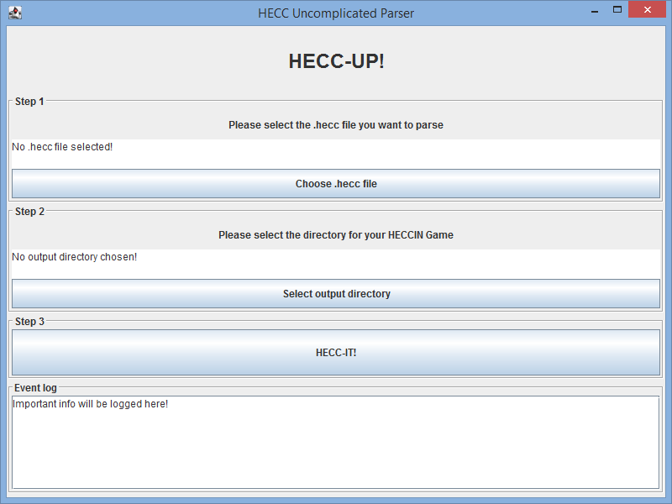
HECC-UP (HECC Uncomplicated Parser)
Give it a .hecc file and a location to save a HECCIN Game to
It’ll use that .hecc file to make a HECCIN Game.
Or it’ll complain if there’s a problem with your .hecc file
And it’ll tell you what caused the HECC-UP!

Slide 9

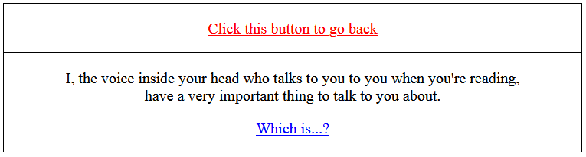
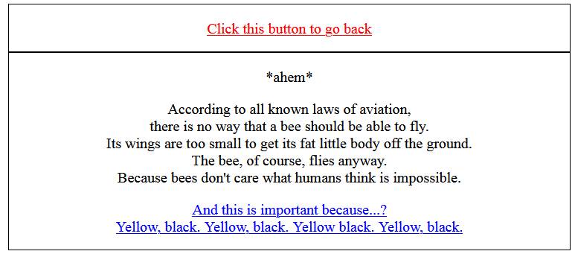
HECCIN Game (HECC-Infused Nice Game)
A hypertext game.
3 parts
Index.html
Baked into HECC-UP, players see this.
heccer.js
HECC Environment for Runtime
Baked into HECC-UP, finite state machine for the passages
hecced.js
HECC Exported Data
Generated from the .hecc code, gives passage data to the heccer.

Slide 10
Usage of Jira
276 hours in total logged on Jira (as of 9/12/2020)
Splitting big tasks into subtasks
Although, for OH-HECC, I kinda forgot to mark the first subtask as done and I basically logged all the work for that under that singular subtask
Some use of releases
Summer prep work was filed away into a release
Challenge Week work was filed away into a release
This term’s work will be filed away into a release too
Bugs etc. reported on Jira as well

Slide 11
Usage of gitlab
Everything’s on my gitlab repo
153 commits as of 9/12/20
Technical documentation for the project itself is available on the repo
See the ‘Technical Documentation’ folder (auto-generated via Javadoc comments in the source code)
Mainly used branches as archives of the project at certain points in time
End of summer, end of challenge week, after this term, etc.

